Slide 1
Memory Allocator project
Kirollos Ashraf 2019/01194
Youssef Mohamed Abd ElWahab

Slide 2
Memory allocation
Project overview
First-fit Algorithm
Best-fit Algorithm
Worst-fit Algorithm

Slide 3
Overview
Memory allocation techniques used in different situations which depends on the waste of memory , the efficiency , and the speed of the using memory.

Slide 4
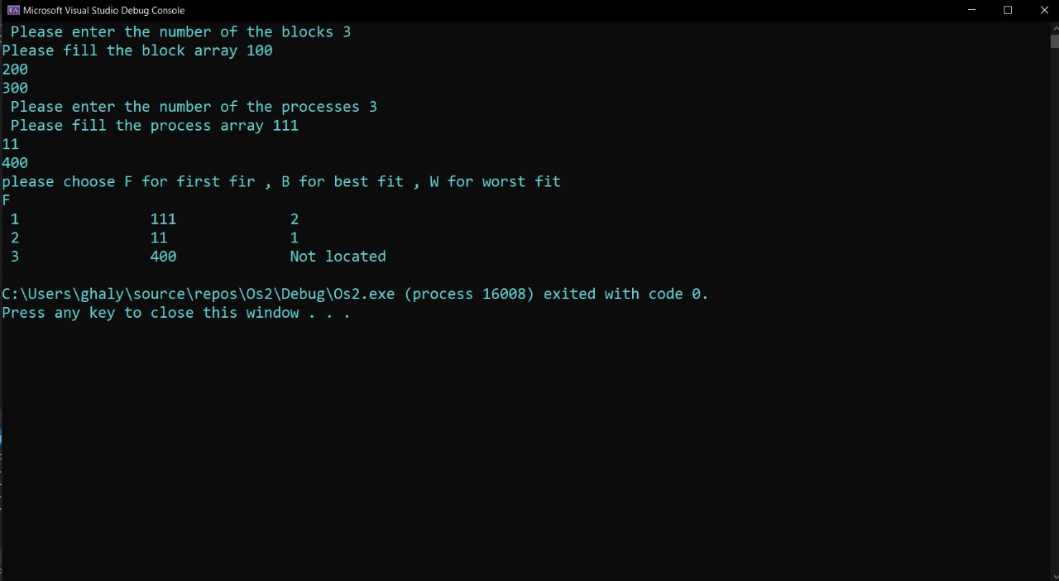
First-fit
In the first fit approach is to allocate the first free partition or hole large enough which can accommodate the process. It finishes after finding the first suitable free partition.

Slide 5
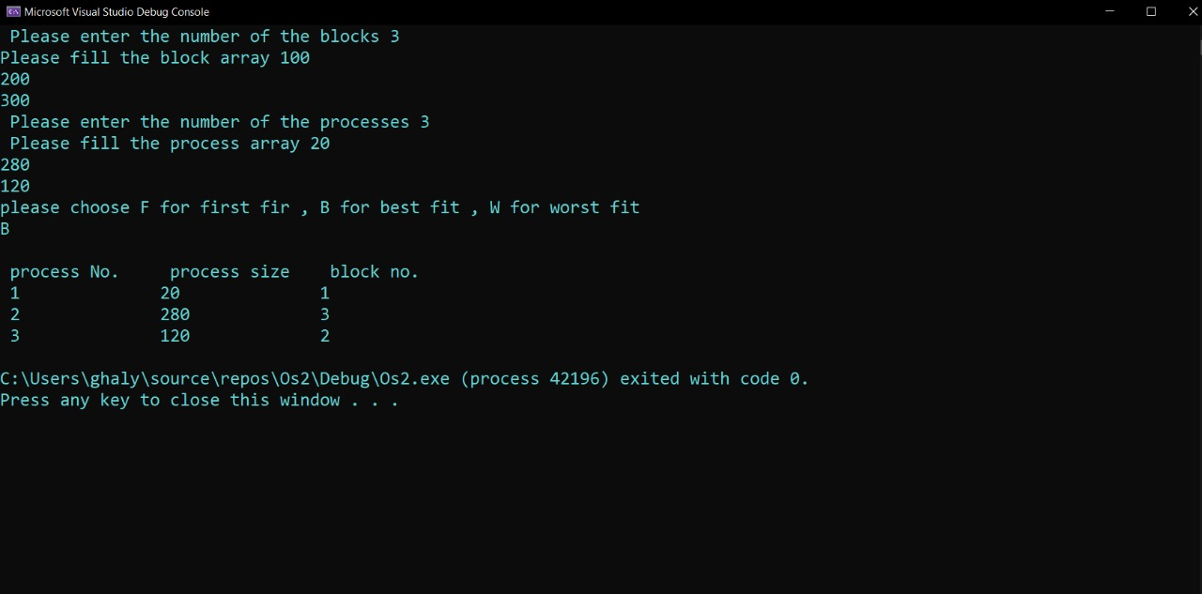
Best-Fit
The best fit deals with allocating the smallest free partition which meets the requirement of the requesting process. This algorithm first searches the entire list of free partitions and considers the smallest hole that is adequate. It then tries to find a hole which is close to actual process size needed.

Slide 6
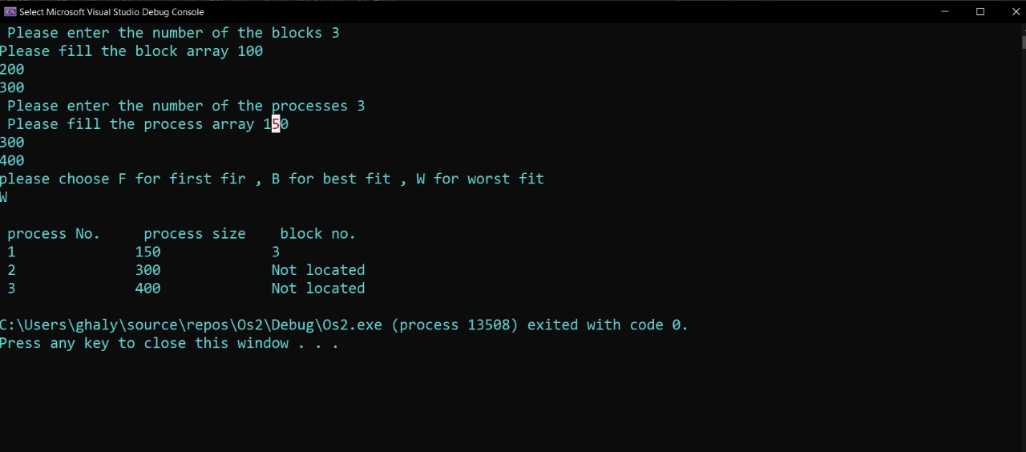
Worst-fit
In worst fit approach is to locate largest available free portion so that the portion left will be big enough to be useful. It is the reverse of best fit.

Slide 7


